Slide 1

Object Oriented Programming with example
Presented By :
K.Malsawmhlua
MCA-II Semester, R/N - 25

Slide 2
Characteristic Exhibited by procedure-oriented programming :-
Emphasis is on doing things(algorithms)
Large programs are divided into smaller programs known as functions.
Most of the functions share global data.
Data move openly around the system from function to function.
Functions transforms data from one form to another.
Employs top-down approach in program design.

Slide 3
Object – Oriented Programming Paradigm
OOP treats data as a critical element in the program development and does not allow it to flow freely around the system.
It ties data more close to the functions that operate on it.
It protect data from accidental modification from outside functions.
OOP allows us to decompose a problem into a number of entities called objects and then builds data and function around these entities.

Slide 4
Some of the striking features of object-Oriented programming :-
Emphasis is on data rather than procedure.
Programs are divided into what are known as objects.
Data structures are designed such that they characterize the objects.
Functions that operate on the data of an object are tied together in the data structure.
Data is hidden and cannot be accessed by external functions.
Objects may communicate with each other through functions.
New data and functions can be easily added whenever necessary.
Follows bottom-up approach in program design.

Slide 5
Definition of Object-Oriented programming
“Object-Oriented programming is an approach that provides away of modularizing a programs by creating partitioned memory area for both data and functions that can be used as templates for creating copies of such modules on demand.”

Slide 6
BASIC CONCEPTS OF OBJECT-ORIENTED PROGRAMMING
1. Objects 2.Classes
3. Data abstraction 4. Data encapsulation
5. Inheritance 6.Polymorphism
7. Dynamic binding 8. Message passing

Slide 7
OBJECTS
Objects are the basic run-time entities in an object-oriented system. They must represent a person, a place, a bank account, a table of data such as vectors, time and lists. Programming problem is analyzed in terms of objects and the nature of communication between them.

Slide 8
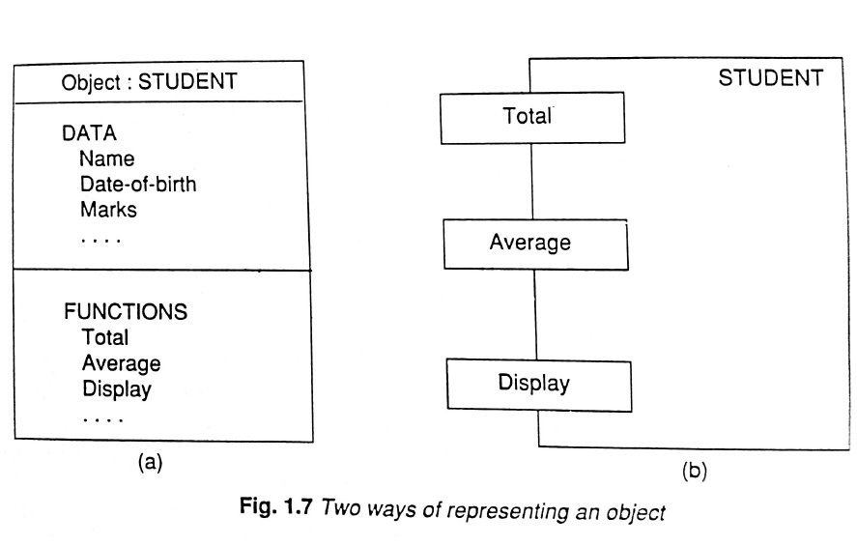

Slide 9
Classes
The entire set of data and code of an object can be made of a user-defined data type with the help of a class.
Object are variable of type Class. Each object is associated with the data of type class with which they are created.
A class is thus a collection of objects of similar type.
Classes are user-defined data types and behave like the built-in-types of a programming language
For Eg :- fruit Mango

Slide 10
Data Abstraction and Encapsulation
The Wrapping up of data and functions into a single unit(called Class) is known as encapsulation. Data encapsulation is the most striking feature of a class.
The insulation of the data from direct access by the program is called data hiding.

Slide 11
Abstraction
Abstraction refers to the act of representing essential features without including the background details or explanations.
Classes use the concept of abstraction and are defined as a list of abstract attributes such as size, weight, and cost, and functions to operate on these attributes.

Slide 12
Inheritance
Inheritance is the process by which objects of one class acquire the properties of objects of another class. It supports the concept of hierarchical classification.
For example, the bird robin is a part of the class flying bird which is again a part of the class bird.

Slide 13
Polymorphism
Polymorphism means the ability to take more than one form. For Eg, an operation may exhibit different behaviour in different instances. The behaviour depends upon the types of data used in the operation.
For eg, consider the operation of addition. For two numbers, the operation will generate a sum. If the operands are strings, then the operation would produce a third string by concatenation.

Slide 14
The Principal Advantages of OOP
Through inheritance, we can eliminate redundant code and extent the use of existing classes.
We can build programs from the standard working modules that communicate with one another, rather than having to start writing the code form scratch. This leads to saving of development time and higher productivity.

Slide 15
The principle of data hiding helps the programmer to build secure programs that cannot be invaded by code in other parts of the program.
It is possible to have multiple instances of an object to co-exist without any interference.
It is possible to map objects in the problem domain to those objects in the program.
It is easy to partition the work in a project based on objects.
Object-oriented systems can be easily upgraded from small to large systems.
Software complexity can be easily managed.

